Slide 1


ERM1 Tutorial
Winter Semester 2023/2024
Week 1: 25.10.2023
Shravani Daftardar
Piumal Mahawasala

Slide 2

What is ERM1 all about?
Empirical Research Methods = systematic collection and analysis of data (i.e. observation and evidence)
In this course, you will learn about...
Basic empirical concepts and research philosophy
Developing an experiment design
Quality aspects of scientific texts
Designing questionnaires and measuring their validity & reliability
Using SPSS and preparing datasets
Parametric and non-parametric approaches to data analysis
Multi-level analysis
...
Notes:
- In EduTech, research is conducted on various aspects of human learning, psychology, media pedagogy and so on. Theories and practices generally based on empirical data.
Important course from POV of ERM2 and Master thesis
- Image from Freepik

Slide 3


Who are we?
Prof. Dr. Albulene Grajcevci (you will meet her on Monday, 30.10.2023!)
Shravani Daftardar
3rd semester EduTech student From Pune, India Bachelors’ in Psychology Employed as a Working Student at Scheer Research Institute
Piumal Mahawasala
3rd semester EduTech student From Colombo, Sri Lanka BSc in Computer Science Master of Education Employed as a Research Assistant at DFKI
Notes:
Change in instructor, new professor coming in, hence also change in course content, format and assignments. No point in contacting previous generation :(

Slide 4
How can you reach us?
Official Tutorial timeslots: Wednesdays 10-12h
Drop us a Teams message (may take up to 24 hours to respond)
Email:
shda00002@stud.uni-saarland.de (Shravani) kyma00002@stud.uni-saarland.de (Piumal)
Notes:
Need to decide our tutor hours

Slide 5

ERM1 Moodle Course
Go to Saarland University Moodle Log in (Universitat des Saarlandes), use UdS ID and password
Home Bildungswissenschaften Educational Technology Wintersemester 2023/24 Empirical Research Methods 1 WiSe 23-24
Enrolment Key: ERM1_stats
You will find lecture & tutorial materials, exercise sheets and more resources here.
This is also where you will submit your weekly assignments!
Notes:
Need to decide our tutor hours

Slide 6
Overall structure of the course
Lectures conducted every Monday + materials given to students to dive deeper into the topic of the week
Hands-on classroom activities and tasks
Weekly individual assignments e.g. reflections on theory, data analysis using SPSS etc. = 40% of final grade
Written final exam (date & time TBD) = 60% of final grade
Tutorials (highly recommended) every Wednesday to help with queries / clarification on specific topics / assignments
Notes:
format, what will be covered, how?
Collect list of students not in Germany yet

Slide 7
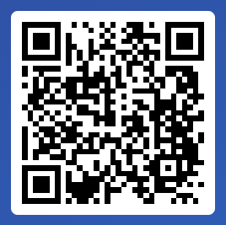

Let’s talk SPSS!!!
Please click on this link OR scan the QR code to answer this poll:
https://app.sli.do/event/stNWHsPfrQ85SuRrSQ8VSM
Notes:
Poll to find out how many people know SPSS as prof. has asked us to collect this info

Slide 8

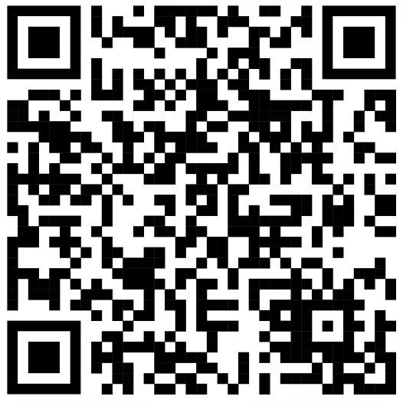
Please share your info so we can contact you easily :)
Link to the form : https://forms.gle/mNx8EWpYF4N93zpm8

Slide 9
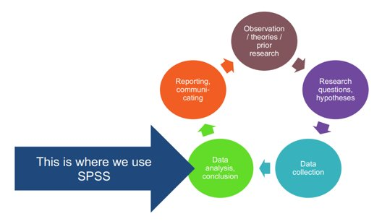
About SPSS
Statistical Package for the Social Sciences (aka IBM SPSS Statistics)
Software package used for manipulation and analysis of statistical data
In a quantitative research context:
Notes:
UdS has software licenses for their students. You can use the program for free. In the seminar and in the exam we will use SPSS.

Slide 10
Steps for requesting SPSS:
1. Open this link: https://www.hiz-saarland.de/dienste/software-lizenzen/spss/
2. Click on 'Software Portal' (section How do you get the software)
3. In the new window, click on 'SPSS for Saarland University'
4. Scroll down until IBM SPSS Statistics 27/26/25 - Students of the UdS and change the quantity from 0 to 1 > click on Kaufen
Notes:
Optional: show them video? https://web.microsoftstream.com/video/ac78c2fc-d542-488d-93b9-17ba739ff174?referrer=https:%2F%2Fedutech.uni-saarland.de%2F
If link inaccessible, they can google HIZ software portal → online registrieren / einloggen

Slide 11
Steps for requesting SPSS :
5. You will be asked to fill a form (no need for the stamp and please, select the student option), save as PDF and send together with your enrolment confirmation to the email address: freischaltungen@asknet.de
Dear Software Portal of the UdS Team,
I attached the form authorization and enrolment confirmation document in order to download the last version of IBM SPSS Stastistics.
Best regards

Slide 12
Steps for downloading SPSS:
6. Once you receive the email confirmation: Open again the link: https://www.hiz-saarland.de/dienste/software-lizenzen/spss/
7. Click on 'Software Portal' (section How do you get the software)
8. Write your user and password and click on continue
9. In the search option, write SPSS
10. Choose the last option in the table and change the quantity from 0 to 1, click on buy now and then click on order
11. Accept the terms and conditions and click on continue
12. Click on Pay now and later click on 'shelf'
13. Download the 3rd option and also the option of 'spss-statistics-26-installation-activation.pdf'

Slide 13

Questions?
Thank you for your attention :)
Next session: Lecture by Prof. Albulene Grajcevci on Monday, 30.10.2023 from 10-12h

